Slide 1
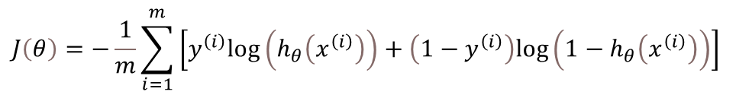

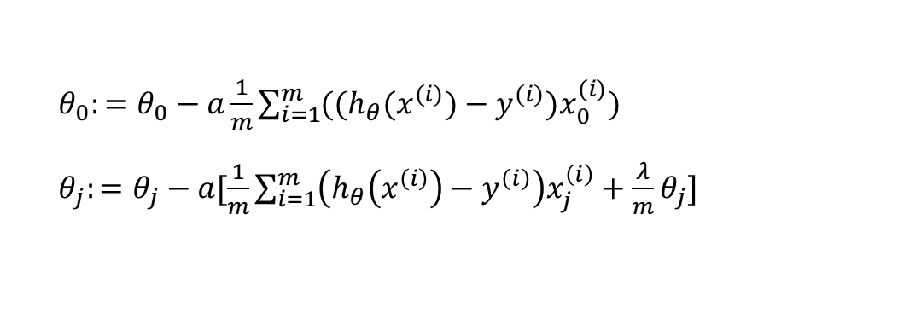
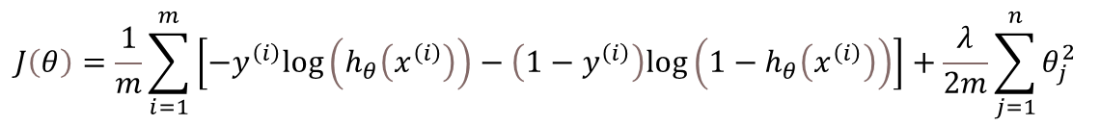
项目背景：根据诊断指标x₁……x_{n}来判断是否有糖尿病，y = 0, 1
实现方法：用${y=θ}^{T}X$拟合数据，传入sigmoid函数得到概率，设定阈值，大于阈值判断为1，小于阈值判断为0。
1. 写出假设函数
$h_{θ}\left(x\right)=g\left(θ^{T}X\right)$，其中$g\left(z\right)=\frac{1}{1+e^{−z}}$ (sigmoid函数)
逻辑回归
$$J\left(θ\right)=−\frac{1}{m}\sum_{i=1}^{m}{\left[y^{\left(i\right)}log\left(h_{θ}\left(x^{\left(i\right)}\right)\right)+\left(1−y^{\left(i\right)}\right)log\left(1−h_{θ}\left(x^{\left(i\right)}\right)\right)\right]}$$
2. 确定损失函数
$$J\left(θ\right)=\frac{1}{m}\sum_{i=1}^{m}{\left[−y^{\left(i\right)}log\left(h_{θ}\left(x^{\left(i\right)}\right)\right)−\left(1−y^{\left(i\right)}\right)log\left(1−h_{θ}\left(x^{\left(i\right)}\right)\right)\right]}+\frac{λ}{2m}\sum_{j=1}^{n}{θ_{j}^{2}}$$
3. 引入正则化惩罚
$θ_{0}:=θ_{0}−a\frac{1}{m}\sum_{i=1}^{m}{((h_{θ}(x^{(i)})−y^{(i)})x_{0}^{(i)}})$
$θ_{j}:=θ_{j}−a[\frac{1}{m}\sum_{i=1}^{m}{\left(h_{θ}\left(x^{\left(i\right)}\right)−y^{\left(i\right)}\right)x_{j}^{\left(i\right)}}+\frac{λ}{m}θ_{j}]$
4. 求解参数
5. 模型评估

